Slide 1
MUNICIPAL SOLID WASTE MANAGEMENT 18CEO306T UNIT II

Slide 2
Unit 2
Waste Generation and source reduction
Waste Stream Assessment (WSA)
Rationale for analysis Field investigation
Onsite segregation and resource recovery
Waste Generation and Composition
Factors causing variation
Materials used for onsite storage containers
Source Reduction: Basics
Purpose and Implementation
Monitoring and Evaluation
Storage and collection of recyclables
Processing equipments for recycling
Material recovery facilities (MRF’s)
Significance of Recycling
Advantages and disadvantages in resource recovery
Tutorial 3: Source Reduction and Recycling in Bangalore:
Tutorial 4: Problems solving in recycling

Slide 3
WASTE GENERATION AND SOURCE REDUCTION
Waste Generation:
Solid waste generation rates and composition vary from country to country depending on the economic situation, industrial structure, waste management regulations and life style.
However, there are several other factors in cities including ‘degree of urbanization’ that equally influence the generation rate.
MSW generation in the East Asian region has been increasing at a rate of 3 to 7% per year as a result of population growth, changing consumption patterns, and the expansion of trade and industry in urban centers.

Slide 4
WASTE GENERATION AND SOURCE REDUCTION
Waste Generation:
The average rate of MSW generation in Asian cities ranges from 0.5 to 1.3 kg/capita/day, which is found to have a direct correlation with the per capita income of the city.
In industrialized cities where the per capita income is high like the cities in Japan, the average rate of generation can be as high as 1.64 kg/capita/day, whereas in low income cities like in India or Bangladesh or China or Sri Lanka, the rate is 0.64 kg on a per capita average.

Slide 5
WASTE GENERATION AND SOURCE REDUCTION
Waste Generation:
For middle-income cities like in Thailand or Malaysia, average rate is about 0.74 kg/capita/day.
The waste generation rate in rural areas is found to be much lower compared to the urban areas in many of the countries in Asia.
In African cities, the per capita waste generation rate is also in the same range of 0.45 to 1.3 kg/ capita/ day. The waste generation rate in developed countries varies from 0.8 to 2.0 kg/capita/day.

Slide 6
WASTE GENERATION AND SOURCE REDUCTION
Waste Generation:
In developing countries, the volume of waste generated varies from day to day and season to season. The rate is often less during the weekends compared to weekdays.
This is primarily because a large number of people come to work in the big or medium cities from the suburb and nearby residential areas that lie beyond the city limits.
For this reason the rate of generation remains high during the weekday and decreases during the weekends. Similarly, the quantity of waste generation increases during the festive days. For example, after a very popular festival in India, the amount of paper waste generated rises tremendously due to a huge amount of fireworks and crackers being used during the festival.

Slide 7
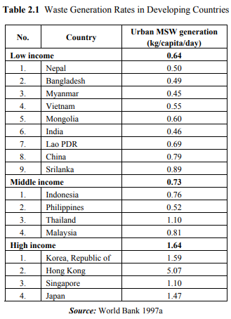
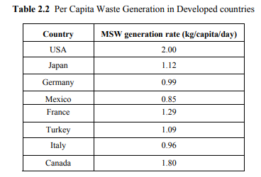
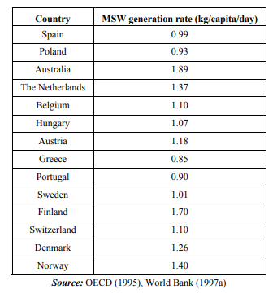

Slide 8
WASTE GENERATION AND SOURCE REDUCTION
Waste Generation:
The growing world population is causing negative impacts on the planet. The current model of production and consumption generates a lot of waste that, in many cases, does not get reused or recycled.
For instance, in India approximately 0.500 gram, in Europe, every citizen generates an average 1.69 kg of waste a day, i.e. 620 kg per year. Sixty percent of the volume of waste generated comes from packaging and product containers, often designed for just a single use.

Slide 9
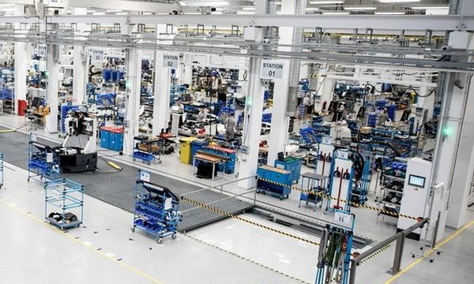
WASTE GENERATION AND SOURCE REDUCTION
The amount of generation of all waste, both hazardous and non-hazardous, generated by main groups of industries or sectors of the economy, expressed per capita and per unit of value added (in US $) by economic activity (at constant prices).
The recommended categories are based on the International Standard Industrial Classification of All Economic Activities (ISIC)
Manufacturing

Slide 10
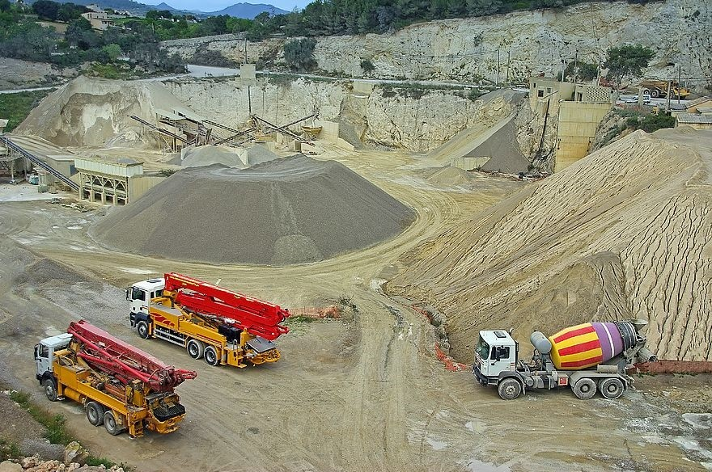
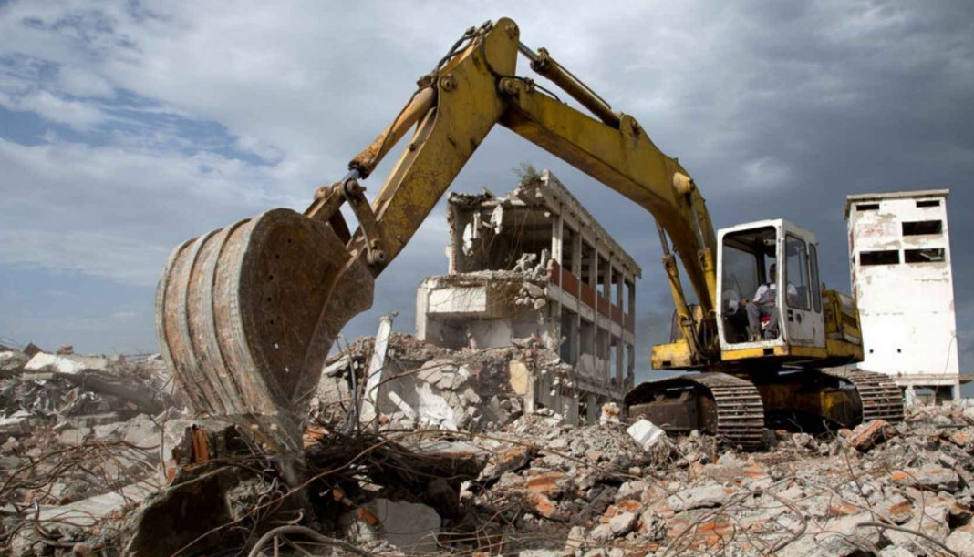
WASTE GENERATION AND SOURCE REDUCTION
Mining and quarrying
Construction

Slide 11
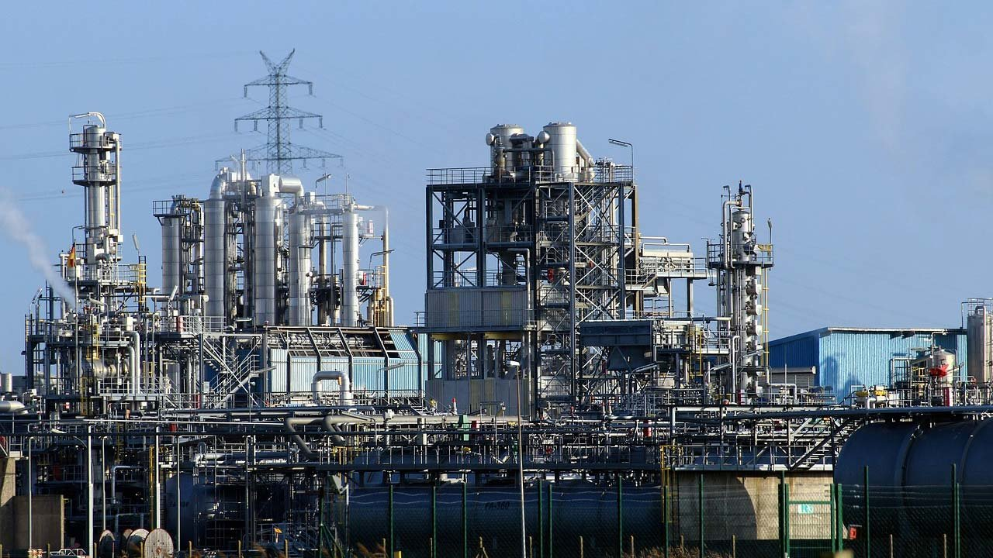
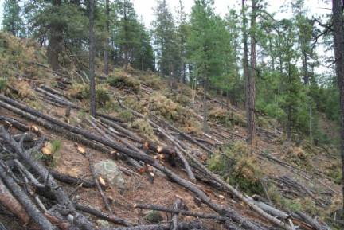
WASTE GENERATION AND SOURCE REDUCTION
Electricity, Gas, steam and air conditioning supply;
Agriculture and forestry

Slide 12
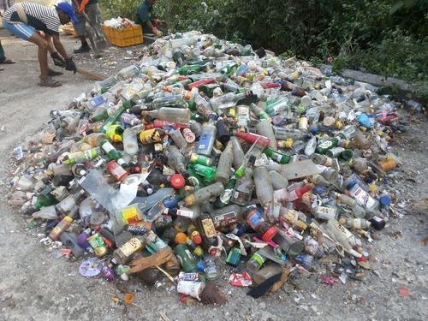
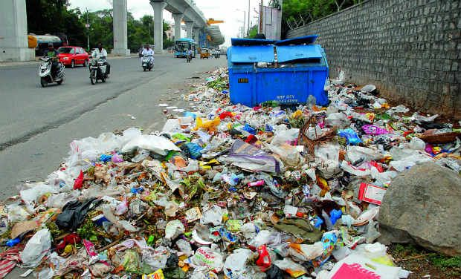
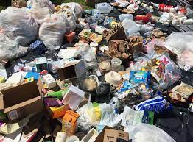
WASTE GENERATION AND SOURCE REDUCTION
All other economic activities
Households

Slide 13
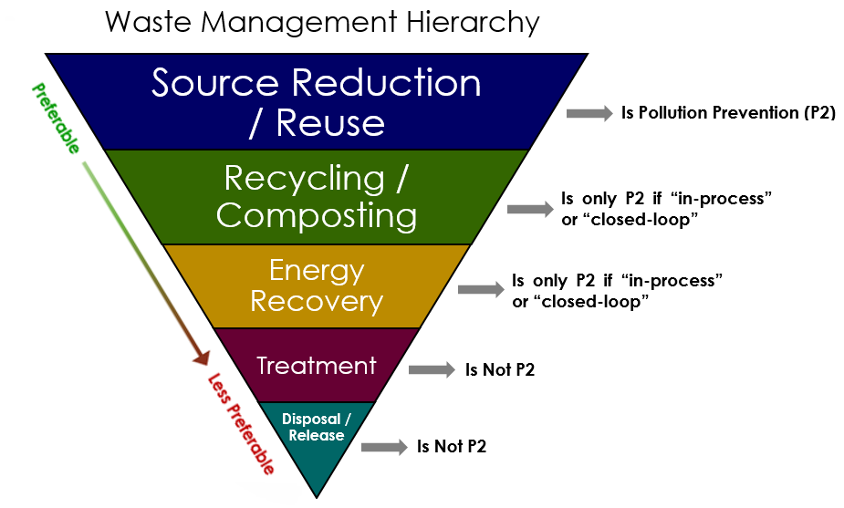
WASTE GENERATION AND SOURCE REDUCTION
Source reduction:
Activities designed to reduce the volume or toxicity of waste generated, including the design and manufacturing of products with minimum toxic content, minimum volume of material, and/or a longer shelf life

Slide 14
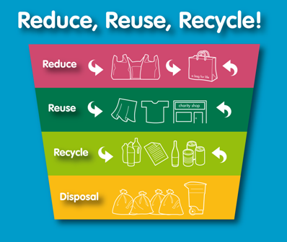
WASTE GENERATION AND SOURCE REDUCTION
Source reduction:
Reduction - Reduction in generation reduction in amount of material
increase the lifetime of products eliminate the need for products
Reuse - no transformation being used for the same purpose again
Recycle - Use of the material as a source raw material, involves physical transformation
Recovery - Process to recover useful material from mixed waste (energy is an example)

Slide 15
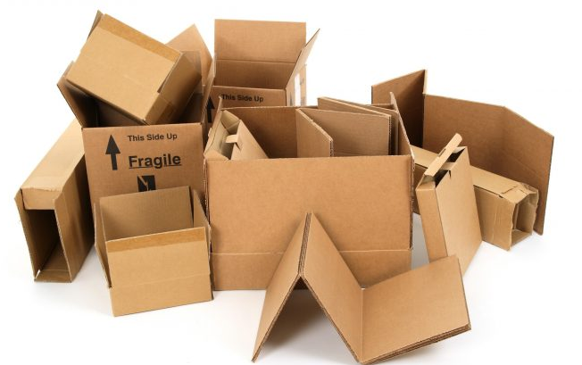
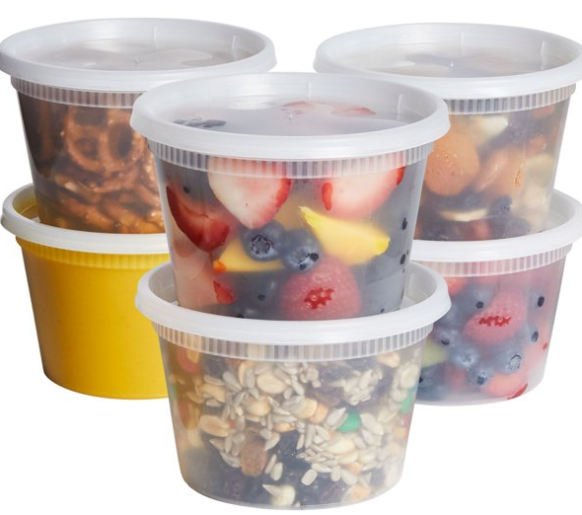
WASTE GENERATION AND SOURCE REDUCTION
Example of Source Reduction:
Using durable coffee mugs.
Using cloth napkins or towels.
Refilling bottles.
Donating old magazines or surplus equipment.
Reusing boxes.
Turning empty jars into containers for leftover food.
Purchasing refillable pens and pencils.

Slide 16
WASTE STREAM ASSESSMENT (WSA)
Waste Stream Assessment:
Waste Stream used to determine quantity (i.e the amount of waste generated in the community, both in terms of weight and volume), composition and sources of wastes.
Waste stream assessment is not a one-time activity. It is a continuous and dynamic process, because the characteristics of wastes differ depending on the regions, communities, seasons, etc.

Slide 17
WASTE STREAM ASSESSMENT (WSA)
Waste Stream Assessment:
A waste stream assessment is the process of understanding the mix of material in the local waste stream. A waste stream assessment can be as simple as evaluating existing data that a local government already keeps or it may include an extensive waste sort to estimate quantities of various materials in the waste stream.
Waste stream is a tools can help you analyze your waste stream, realize profit opportunities in other's wastes, and determine the diversion programs that will most effectively help your local government meet and maintain its 50 percent goal.

Slide 18
WASTE STREAM ASSESSMENT (WSA)
Importance of waste stream information
A waste stream assessment should not be conducted only to gather dust on a shelf. It should be a dynamic record that helps a local government prioritize its waste reduction activities.
A waste stream assessment provides local governments with the following benefits:
Identifies major material categories and their quantities in the waste stream.
Helps rank materials according to their impact on the local waste stream.
Helps identify specific commercial/industry types and/or facilities that should be targeted for waste reduction.
Assists in creating local educational materials on solid waste management.

Slide 19
RATIONALE ANALYSIS - FIELD INVESTIGATION
The reasons for the analysis of waste composition, characteristics and quantity include the following:
It provides the basic data for the planning, designing and operation of the management systems.
An ongoing analysis of the data helps detect changes in composition, characteristics and quantities of wastes, and the rates at which these changes take place, which facilitates effective implementation of management systems.
It quantifies the amount and type of materials suitable for processing, recovery and recycling.
It provides information that helps in deciding appropriate technologies and equipment.
The forecast trends assist designers and manufacturers in the production of collection vehicles and equipment suitable for future needs.

Slide 20
RATIONALE ANALYSIS - FIELD INVESTIGATION
Field Investigation
Field investigations may take any one or a combination of the following forms:
Waste sorting: Sorting of wastes into predetermined components takes place at disposal sites for weighing and sampling in order to determine the percentage of each component and the physical and chemical characteristics of wastes.
It is carried out manually, and the sample size for analysis is between 100 and 150 kg. The implements required for the data for the planning, designing and operation of the purpose include sorting table, measuring box, bins or boxes to contain sorted materials and platform weighing machine.

Slide 21
RATIONALE ANALYSIS -FIELD INVESTIGATION
Field Investigation:
Vehicle weighing: Vehicles are weighed when they enter the disposal sites loaded, and exit the sites empty. The vehicle’s front wheels are weighed first, followed by the rear wheels and the sum of the two gives the total weight.
Weighing is carried out each day of the weighing period in order to determine the average weight. The weighing of loaded and unloaded vehicles is accomplished with a weighing scale or weighbridge. Ideally, the weighing scale should be operated during the entire period of operation of the disposal site, round the clock, if necessary.
An electronic or a mechanical portable axle scale, with a capacity of 20 tones is suitable for the purpose. An electronic scale comprises two load-cell platforms and an electronic control and a display unit.

Slide 22
RATIONALE ANALYSIS -FIELD INVESTIGATION
The quantity of waste measured at disposal sites reflects a disposal factor rather than a generation factor, since the measurements do not include wastes that are:
salvaged at the generation and disposal sites;
disposed of in unauthorized places such as vacant plots, alleys, ditches, etc.;
salvaged by collectors;
lost during transport.
Field visits: This means visiting institutional and industrial sites to identify wastes being generated and disposal methods. Field visits involve visiting the facility, i.e., industry, institutions, etc., viewing the waste handling system and completing a questionnaire with the assistance of the plant manager or senior technical personnel who usually investigate wastes from industries and institutions. Collection of samples in sealed polythene bags follows for laboratory analysis to identify physical and chemical characteristics. Each sample may be in the range of 1.5 to 5 kg.

Slide 23
ONSITE SEGREGATION AND RESOURCE RECOVERY
Onsite segregation:
Waste segregation refers to the separation of dry and wet garbage, which paves the way for other concepts of waste management like composting, recycling and incineration.
India generates 62 million tonnes (MT) of waste every year, and only 43 MT is collected. Of the collected waste, close to 31 MT is dumped on landfill sites or water bodies and only 11.9 MT is scientifically treated, disposed of in unauthorized places such as vacant plots, alleys, ditches, etc.;
Wet/Kitchen Waste:
This comprises of items like fruit peels, leftovers, vegetable skins, uncooked food, coffee or tea powder, and garden waste like leaves and twigs. Maintain a drum, container or a bin to deposit such waste, so that it can be converted into rich organic compost. You can choose your composting process. Examples include vermicomposting, aerobic and anaerobic composting.

Slide 24
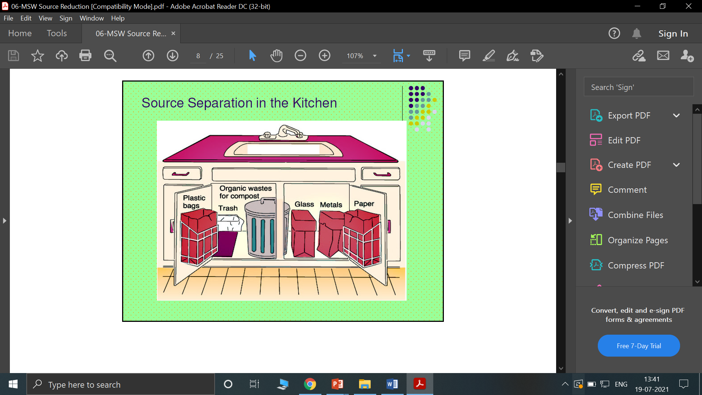
ONSITE SEGREGATION AND RESOURCE RECOVERY
Dry waste:
Dry waste is divided into recyclable and non-recyclable waste. Items like used paper towels, hazardous chemical or food containers, foam materials, and dishware are some examples of dry waste that cannot be recycled or reused.
Dry recyclable waste includes pet bottles, plastic carry bags, newspapers, glass bottles, shoes, plastic cutlery, tires, cardboard, and so on.
If the recyclable waste is segregated further, it can fetch you money or goodies, local scrap dealers, recycling centres, raddiwalas to municipal corporations, there are several sources you can submit your dry waste to and get something in return.

Slide 25
ONSITE SEGREGATION AND RESOURCE RECOVERY
Electronic waste Segregation:
There are three types of electronic waste you must be aware of:
Bulky: Fridge, microwave or anything is that is difficult to carry around.
Hazardous: Tube lights, light bulbs, toner cartridges, batteries, monitors and screens. Anything with a chemical component.
Non-hazardous: Cables, chargers, microwaves, gadgets like laptops and phones, there are several sources you can submit your dry waste to and get something in return.
Most of the offices follow a two-bin system—one for recyclable waste and one for wet garbage. But just like your home, the more you segregate, the better the waste management.
A bin for wet waste like leftover food, vegetable or fruit peels, tea bags, etc. in the canteen or cafeteria. If the volume of wet waste is vast, an office can also follow on-site composting.

Slide 26
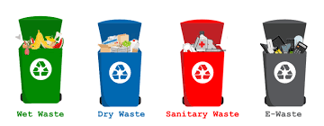
ONSITE SEGREGATION AND RESOURCE RECOVERY
Dry waste should be further divided into plastic, metal, glass and paper. Send each type of garbage every week to recycling centre's or services.
Electronic waste like CDs, pen drives, bulbs, tube-lights, computer systems, electric cables, keyboards, batteries, motherboards etc. should be collected by the office and transported to e-waste collection centre's.
Bins should be placed in bathrooms for sanitary waste like pads. Some offices even install incinerators to treat it at the source.

Slide 27
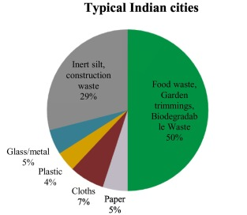
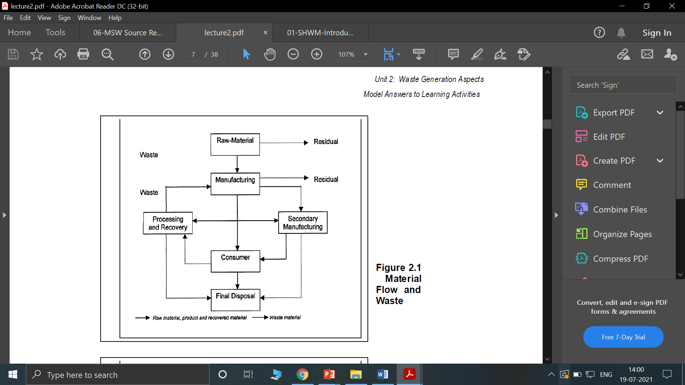
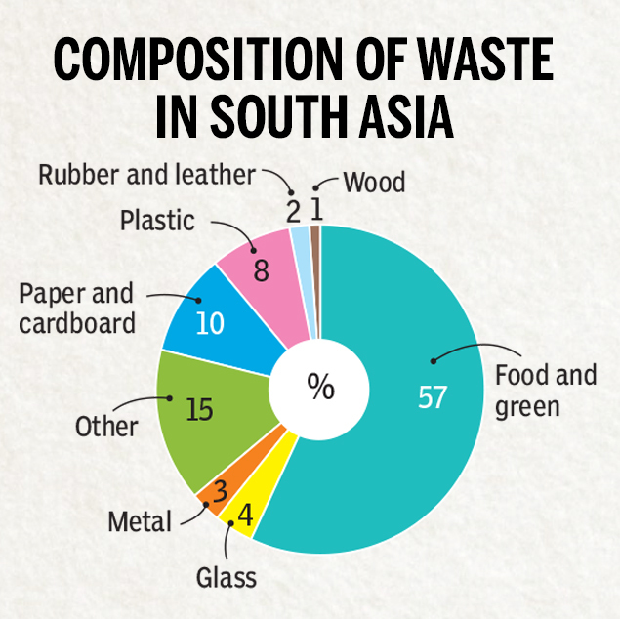
WASTE GENERATION AND COMPOSITION
Waste Generation:

Slide 28
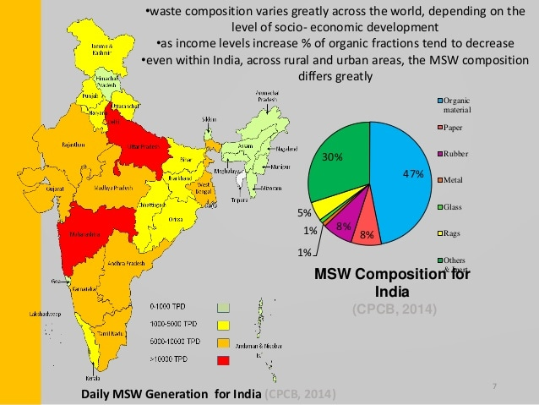
WASTE GENERATION AND COMPOSITION

Slide 29
WASTE GENERATION AND COMPOSITION
Waste Generation:
Waste generation encompasses those activities in which waste, be it solid or semi-solid material, no longer has sufficient economic value for its possessor to retain it.
The processing of raw materials is the first stage when wastes are generated, and waste generation continues thereafter at every step in the process as raw materials are converted into final products for consumption.
In below flowchart suggests that we can reduce the amount of solid waste by limiting the consumption of raw materials and increasing the rate of recovery and reuse.
There needs to be, therefore, a societal change in the perception of wastes. This sounds simple. But, implementing changes in the society is difficult, unless appropriate management solutions are provided.

Slide 30
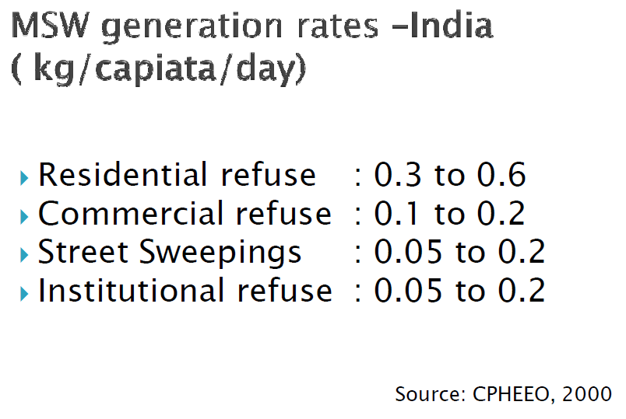
WASTE GENERATION AND COMPOSITION
Waste Generation:

Slide 31
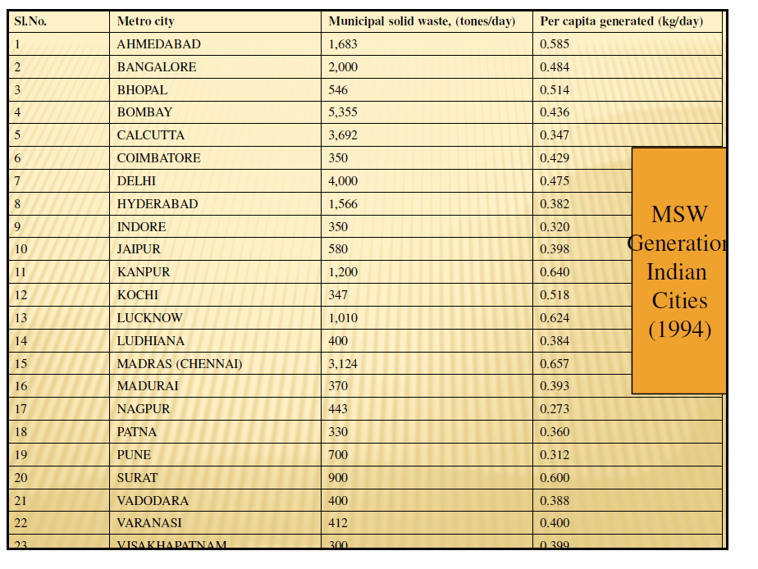
WASTE GENERATION AND COMPOSITION

Slide 32
WASTE GENERATION AND COMPOSITION
Waste Composition:
Some of the general observations associated with the composition of wastes include the following:
The major constituents are paper and decomposable organic materials.
More often than not, metal, glass, ceramics, textile, dirt and wood form part of the composition, and their relative proportion depends on local factors.
Average proportions of the constituents reaching the disposal sites are consistent and urban wastes are fairly constant although subject to long-term changes such as seasonal variations.
MSW composition in India is approximately 40%–60% compostable, 30%–50% inert, and 10%–30% recyclable. According to the National Environmental Engineering Research Institute (NEERI), Indian waste consists of 0.64%±0.8% nitrogen, 0.67%±0.15% phosphorus, and 0.68%±0.15% potassium.

Slide 33
WASTE GENERATION AND COMPOSITION
Waste Composition:
Waste composition also varies with socio-economic status within a particular community, since income determines life-style – consumption patterns and cultural behavior.
Several conclusions may be drawn from this comparative data: · The proportion of paper waste increases with increasing national income; · The proportion of putrescible organic matter (food waste) is greater in countries of low income than those of high income.
Variation in waste composition is more dependent on national income than geographical location, although the latter is also significant; · Waste density is a function of national income, being two to three times higher in the low-income countries than in countries of high income; · Moisture content is also higher in low-income countries; and · The composition of waste in a given urban center varies significantly with socio-economic status (household income).
The detailed Waste composition were discussed Table 1. Waste Composition

Slide 34
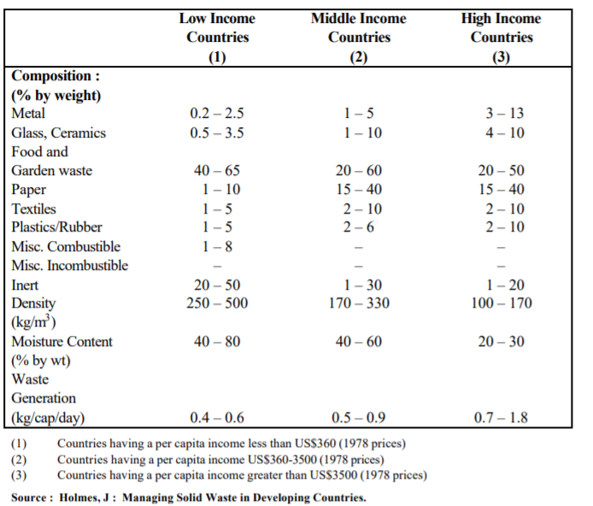
WASTE GENERATION AND COMPOSITION

Slide 35
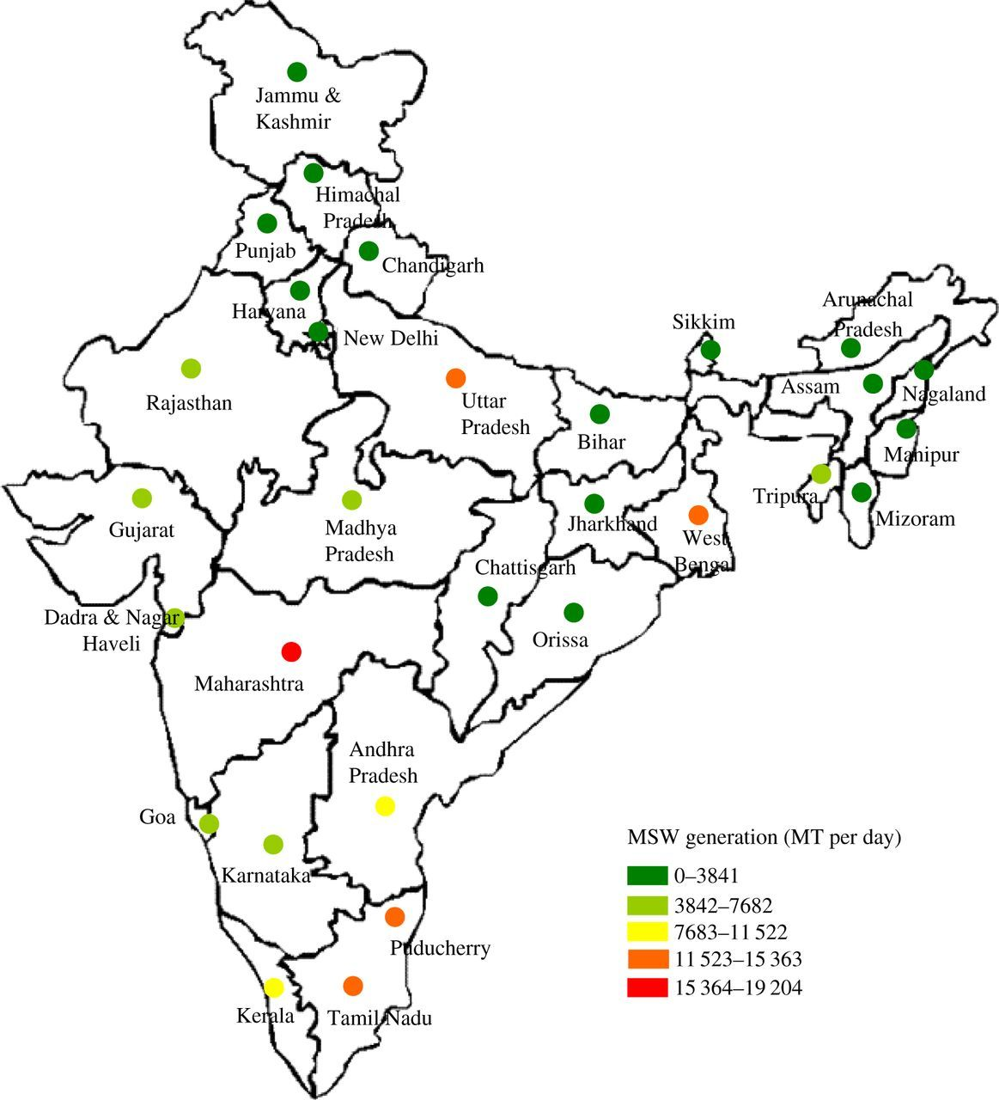
FACTORS CAUSING VARIATION
Source reduction /Recycling
Geographic location
Season
Frequency of collection
Legislation
Public attitudes
Per capita income
Size of households
Population density
Historical / Tourist places
Typically population increase explains 1/3 of increase in MSW generation
Refer : https://doi.org/10.1098/rsos.160764

Slide 36
FACTORS CAUSING VARIATION
Geographic location: The influence of geographic location is related primarily to different climates that can influence both the amount of certain types of solid wastes generated and the collection operation. For instance, substantial variations in the amount of yard and garden wastes generated in various parts of India are related to the climate. To illustrate, in the warmer southern areas, where the growing season is considerably longer compared to the northern areas, yard wastes are collected in considerably larger quantities and over a longer period of time.
Seasons: Seasons of the year have implications for the quantities and composition of certain types of solid wastes. For example, the growing season of vegetables and fruits affect the quantities of food wastes.

Slide 37
FACTORS CAUSING VARIATION
Collection frequency: A general observation is that in localities, where there are ultimate collection services, more wastes are collected. Note that this does not mean that more wastes are generated. For example, if a homeowner has access to only one or two containers per week, due to limited container capacity, he or she will store newspapers or other materials in some specified storage area.
However, the same homeowner will tend to throw them away, if there is access to unlimited container services. In this latter situation, the quantity of waste generated may actually be the same but the quantity collected, as it relates to the frequency of collection, is considerably different.

Slide 38
FACTORS CAUSING VARIATION
Legislation: This refers to the existence of local and state regulations concerning the use and disposal of specific materials and is an important factor that influences the composition and generation of certain types of wastes. The Indian legislation dealing with packing and beverage container materials is an example.
Public attitudes: Significant reduction in the quantity of solid waste is possible, if and when people are willing to change – on their own volition – their habits and lifestyles to conserve the natural resources and to reduce the economic burden associated with the management of solid wastes.
Per capita income: The characteristics of the population influence the quantity and composition of waste generated. The amount of waste generated is more in low-income areas compared to that in high-income areas. Similarly, the composition differs in terms of paper and other recyclables, which are typically more in high-income areas as against low-income areas

Slide 39
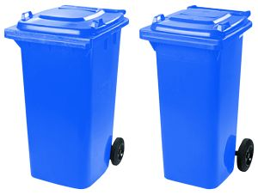
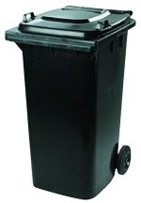
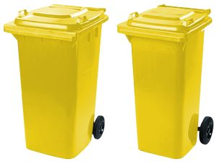
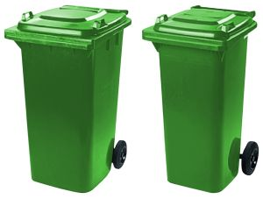
MATERIALS USED FOR ONSITE STORAGE CONTAINERS
Waste storage encompasses proper containers to store wastes and efficient transport of wastes without any spillage to transfer stations/disposal sites.
Garbage and refuse generated in kitchens and other work areas should be collected and stored in properly designed and constructed water-proof garbage cans (waste bins). The censor receptacles can be constructed from galvanized iron sheet or plastic materials. They should have tightly fitting covers.
They must be of such size that, when full, they can be lifted easily by one man. They should be located in a cool place on platforms at least 30 centimeters above ground level. An adequate number of suitable containers should be provided with proper platforms with receptacles stand. The number may depend on the amount, type and establishments where the need arises. Suitable containers should be watertight, rust resistant, with tight-fitting covers, fire-resistant, adequate in size, light in weight, with side handles and washable.

Slide 40
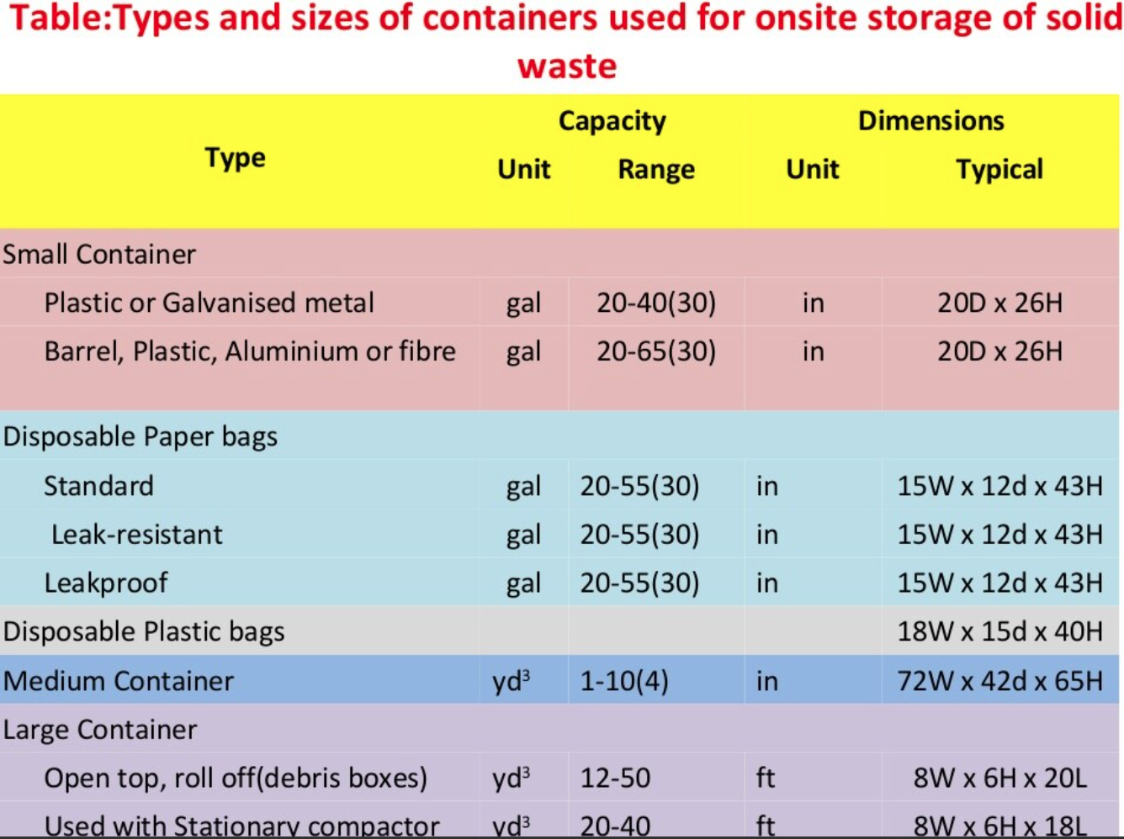
MATERIALS USED FOR ONSITE STORAGE CONTAINERS

Slide 41
SOURCE REDUCTION
Source reduction, also known as waste prevention, is an approach that precedes waste management and addresses how products are manufactured and, purchased.
Reducing waste before it is generated is a logical way to save costs and natural resources, and preserve the local environment

Slide 42
SOURCE REDUCTION
The activities that reduce the amount of waste generated at source as well as activities that involve any change in the design, manufacture, purchase or usage of materials/products to reduce their volume and/or toxicity, before they become part of the solid waste stream
Successful implementation of source reduction programme requires the co-operation of all stakeholders, (e.g., businesses, industries, consumers and state and local governments).

Slide 43
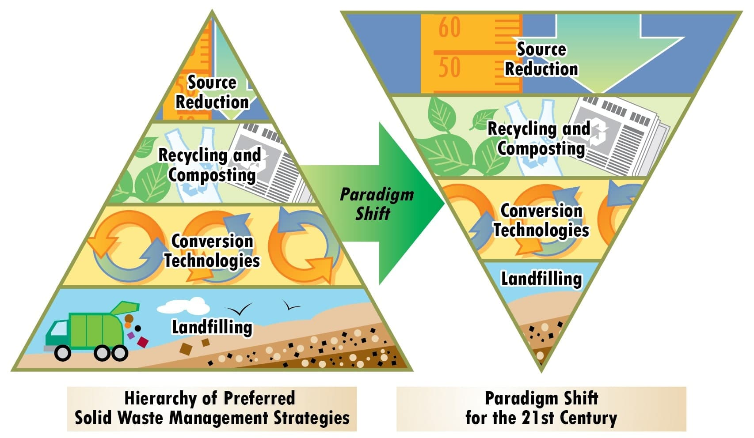
SOURCE REDUCTION

Slide 44
SOURCE REDUCTION
Source reduction programme should be part of a community waste management plan. Source reduction activities vary widely and many factors have to be considered while evaluating them.

Slide 45
VIDEO
https://www.youtube.com/watch?v=DmFGsxLcT6k

Slide 46
PURPOSE OF SOURCE REDUCTION
Product reuse
Material volume reduction
Toxicity reduction
Increased product lifetime
Decreased consumption

Slide 47
PURPOSE OF SOURCE REDUCTION
Product reuse: Using reusable products, instead of their disposal equivalents, reduce the amount of materials that are to be managed as wastes. An example of product reuse is the reusable shopping bag.
Material volume reduction: Reducing the volume of material used changes the amount of waste entering the waste stream. This helps in controlling the waste generated and its disposal. For example, buying in bulk or using large food containers reduces the amount of packaging waste generated.

Slide 48
PURPOSE OF SOURCE REDUCTION
Toxicity reduction: Source reduction reduces the amount of toxic constituents in products entering the waste stream and reduces the adverse environmental impacts of recycling or other waste management activities.
For example, substitution of lead and cadmium in inks (solvent-based to water based) and paints is a source reduction activity.
Increased product lifetime: Source reduction facilitates the use of products with longer lifetime over short-lived alternatives that are designed to be discarded at the end of their useful lives. Put differently, it encourages a product design that allows for repair and continued use rather than disposal. Manufacturing long-life tyres is a good example of increasing product lifetime.

Slide 49
PURPOSE OF SOURCE REDUCTION
Decreased consumption: This refers to the reduced consumption of materials that are not reusable (e.g., using a reusable shopping bag instead of picking up plastic bags from the store).
Consumer education about the materials that are difficult to dispose of or are harmful to the environment is essential. Buying practices can thus be altered (e.g., buying in bulk) to reflect environmental consciousness.

Slide 50
ADVANTAGES OF SOURCE REDUCTION
Reduction in extent of environmental impacts
Reduction in resource consumption and generation of pollution
It includes producer, consumer, prudent and efficient activities

Slide 51
IMPLEMENTATION
Education and research
Financial incentives and disincentives
Regulation

Slide 52
IMPLEMENTATION
Education and research: Consumers, businesses, industries, schools, etc., can implement education and research activities to address the need for source reduction, its consequences, available choices, benefits and costs.
Essentially, the aim of such education and research activities is to provide and develop information about source reduction goals, needs and methods and to elicit voluntary efforts from the public and private sectors to help bring about some specific changes

Slide 53
EDUCATION AND RESEARCH
Exploring and developing funding sources.
Developing curricula for schools and universities
Developing media campaign
Forming stakeholder councils.

Slide 54
IMPLEMENTATION
Financial incentives and disincentives: Linking an economic benefit to the implementation of source reduction activities encourages source reduction.
For example, financial disincentives represent additional costs to the waste producing activities that could be avoided through source reduction activities.

Slide 55
FINANCIAL INCENTIVES AND DISINCENTIVES
01
02
03
04
Tax credit or exemption
variable waste disposal charges for garbage collection
Graduated fee structure for garbage collection
Product disposal charges

Slide 56
IMPLEMENTATION
Regulation: Although most regulation occurs at the national and state level, local authorities can participate in legislative activities in developing regulations that affect municipal SWM.
It is possible, for example, to establish a programme to inform the consumers about environmental impacts, durability, reusability and recyclability of products as well as to declare source reduction as a top priority in SWM.

Slide 57
REGULATION
Quantity control regulation
Product design regulation

Slide 58
RECYCLE MATERIALS
Recycling is the process of converting waste materials into new materials and objects.
The recovery of energy from waste materials is often included in this concept. The recyclability of a material depends on its ability to reacquire the properties it had in its virgin or original state.

Slide 59
STORAGE AND COLLECTION OF RECYCLABLES
Collection of source-separated materials is a necessary component of recycling programme. Establishing a collection system for source-separated materials will require more careful planning than regular trash collection.
Resident convenience
Collection crew convenience
Cost effectiveness
Integrity of materials

Slide 60
STORAGE AND COLLECTION OF RECYCLABLES
Resident convenience: The easier it is for residents to separate materials, the higher the participation and recovery rates will be higher.
Collection crew convenience: The system should be convenient for collection crews. For example, loading and sorting activities should be as simple as possible.
Cost effectiveness: Equipment and procedures must be designed to maximize collection crew and vehicle productivity.
Integrity of materials: The storage and collection system should keep recyclables in the best shape possible. It should be properly handled, dry and contaminant free.

Slide 61

STORAGE AND COLLECTION OF RECYCLABLES

Slide 62
PROCESSING EQUIPMENT FOR RECYCLING
Recycling involves a number of processing techniques and these processes require different equipment's. However, some of the special equipment's used in recycling are
Balers
Can densifiers
Glass crushers
Magnetic separators
Wood grinders
Scales

Slide 63
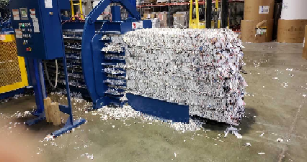
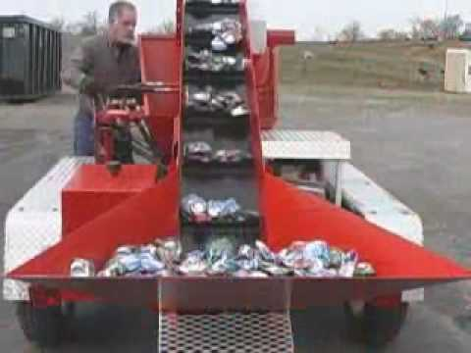
PROCESSING EQUIPMENT FOR RECYCLING
Balers: Balers can be used to densify many types of materials including paper, cardboard, plastics and cans. Balers can improve space utilization and reduce material transportation costs.
Can densifiers: Can crushers are used to densify aluminum and steel cans prior to transport.

Slide 64
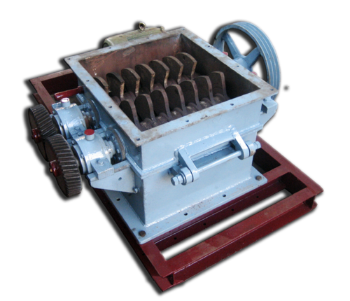
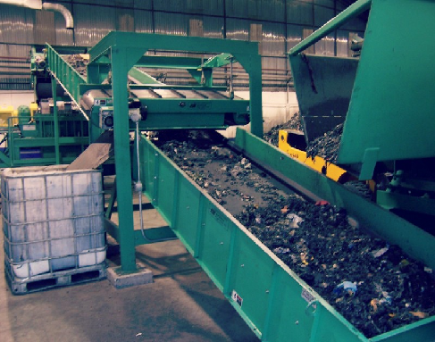
PROCESSING EQUIPMENT FOR RECYCLING
Glass crushers: These are used to process glass fraction separated by color and break it into small pieces. This crushed material is then called cullet, and can be reprocessed into new glass products.
Magnetic separators: These are used to remove ferrous material from a mixture of materials.

Slide 65
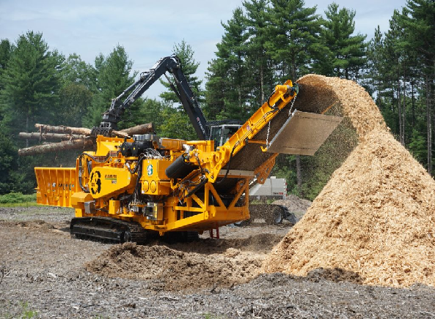
PROCESSING EQUIPMENT FOR RECYCLING
Wood grinders: These are chippers and are used to shred large pieces of wood into chips that can be used as mulch or as fuel.
Scales: These are used to measure the quantity of materials recovered or sold.

Slide 66
MATERIAL RECOVERY FACILITIES (MRF)
MRF is a centralized facility that receives, separates, processes and markets recyclable material. It can be operated with both drop off and curbside programmes. The primary advantage of MRF is that it allows materials directly from the municipalities and processes them uniformly. It is generally designed to handle all type of recyclables. Implementation of MRF in a municipality depends upon a number of factors as follows,
Market demand
Separate collection
Number of different recyclables
Quantities of materials

Slide 67
MATERIAL RECOVERY FACILITIES (MRF)
Market demand: When additional processing is required, MRF is more useful as buyers may have certain material specifications.
Separate collection: In systems that require residents to separate their recyclables, intermediate separation and processing is required.
Number of different recyclables: In general, a MRF will be more beneficial when a large number of different recyclables are collected.
Quantities of materials: Because MRF involves substantial capital and operating costs (e.g., buildings, equipment and labour), it is expected to handle a significant amount of materials to justify its operation.

Slide 68
SIGNIFICANCE OF RECYCLING
Recycling is one of the fundamental parts of the waste management plan.
Although it alone cannot solve a community’s municipal SWM problem, it can divert a significant portion of waste stream from disposal in landfill and combustion facilities.
Recycling has a lot of direct and indirect significance for the society

Slide 69
SIGNIFICANCE OF RECYCLING
Economic significance
Cost reduction
Employment
Energy saving
Reduced health care costs
Environmental and health significance
Improved environment
Natural resource conservation
Social significance

Slide 70
SIGNIFICANCE OF RECYCLING
Economic significance: Economic assessment of waste recycling is a difficult task as many of the beneficial environmental and social impacts of recycling are long-term and are intangible, and, therefore, are difficult to quantify.
Cost reduction: Resource recovery through recycling of solid waste could be of interest to waste management authorities as a means of reducing the waste disposal cost.

Slide 71
SIGNIFICANCE OF RECYCLING
Employment: Recycling of waste is a labour intensive activity, and its potential to ease the unemployment problem is high.
Energy saving: Use of recyclables in some industrial processes is known to consume less energy than the use of any other raw material.
Reduced health care costs: Improved health and sanitary conditions in urban areas resulting from indirect benefits of waste recycling can reduce the investment in public health programme.
Saving costs for other public utilities: Enhanced solid waste recycling practices can reduce the frequency of sewer clogging, blocking of natural watercourses and pollution of water bodies.

Slide 72
SIGNIFICANCE OF RECYCLING
Environmental and health significance: The volume of waste is increasing rapidly because of population growth and economic development.
The composition of waste is also changing, leading to waste production with more recyclables. At the same time, polluted waste fractions are increasing because of increasing complex processes being used in industries, and these contribute increasingly to environmental degradation.

Slide 73
SIGNIFICANCE OF RECYCLING
Improved environment: The environmental pollution may be due to inadequate SWM as well as due to its effect on other urban infrastructure.
Recycling reduces the volume of waste that has to be finally dumped, and thereby causing reduction in pollution at the waste disposal sites
Natural resource conservation: Industries with natural products as their raw material for production are depleting natural resources.
Use of more and more recyclable solid wastes in industrial production will relieve the tremendous pressure on these precious resources

Slide 74
SIGNIFICANCE OF RECYCLING
Social significance: People engaged in waste collection activities are normally of low social and economic standing. This is especially true with scavengers, which is evident from persisting poor quality of their living and working conditions.
Different groups of people engaged in waste recycling have a hierarchical social and economic status, in which, processors are at the top of the hierarchy followed by waste dealers and wholesalers, waste buyers and waste collectors in that very order, while scavengers are at the bottom.

Slide 75
ADVANTAGES AND DISADVANTAGES IN RESOURCE RECOVERY
Recycling helps to reduce energy usage, reduce the consumption of fresh raw materials, reduce air pollution and water pollution (from landfilling) by reducing the need for “conventional” waste disposal and also reduces greenhouse gas emissions.

Slide 76
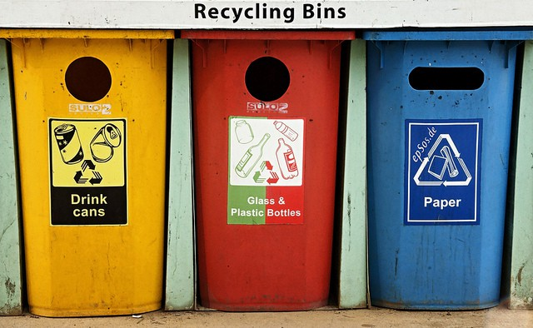

Slide 77
ADVANTAGES OF RECYCLING
1. Recycling minimizes pollution
2. Protects the environment
3. Recycling minimizes global warming
4. Conserves natural resources
5. Recycling cuts down the amount of waste in landfill sites
6. Recycling ensures sustainable use of resources
7. Recycling contributes to the creation of jobs
8. Reduces energy consumption
9. Recycling helps to make and to save money
10. Recycling spreads environmental awareness
11. Recycling can reduce allied activities needed for the production of fresh products
12. Recycling of organic matter
13. Innovations drive scientific advancements

Slide 78
DISADVANTAGES OF RECYCLING
1. High upfront capital costs
2. Recycling sites are always unhygienic, unsafe and unsightly
3. Products from recycled waste may not be durable
4. Recycling might not be inexpensive
5. Recycling is not widespread on large scale
6. More energy consumption and pollution
7. Result in pollutants
8. Increased processing cost and low-quality jobs
9. Stricter and more stringent implementation required
10. Recycling is still ineffective
11. Methane is a GHG
12. Revenue loss

Slide 79
CASE STUDY: SOURCE REDUCTION AND RECYCLING IN BANGALORE
Source reduction, including reuse and recycling, can help reduce waste disposal and handling costs, because it avoids the costs of municipal composting, land filling and combustion.
Source reduction also conserves resources and reduces pollution, including greenhouse gases that contribute to global warming. Waste reduction, reuse and recycling, thus, play an important role in SWM.

Slide 80
CASE STUDY: SOURCE REDUCTION AND RECYCLING IN BANGALORE
In Bangalore, 66% of the waste generated is collected for recovery, i.e., about 2,373 tonnes per day. While 722 tonnes per day is reused, the rest (i.e., 1,450 tonnes) goes for recycling.
The agents involved in the collection and recovery of wastes in the city include waste pickers, IWB (i.e., itinerant waste buyer), middlemen (or intermediaries), the municipality and recycling units (both large and small).
While the three agents in the informal sector and the municipality are directly involved in waste collection activities, the waste is processed by the recycling units, which receive recyclable waste from middlemen and municipality.
Of the 1450 tonnes collected for recycling, 1077.8 tonnes come from intermediaries, 60.4 come from IWB and 312 tonnes come from waste pickers. This amounts to 40% of the total waste (i.e., 3613 tonnes per day) generated.

Slide 81
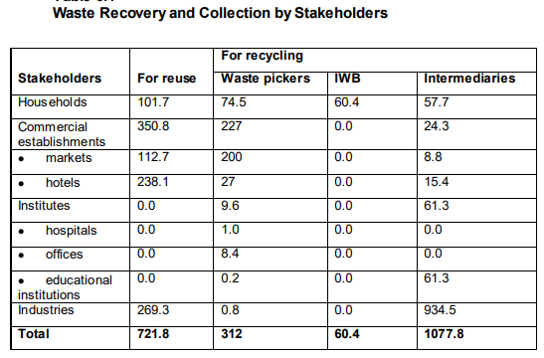
CASE STUDY: SOURCE REDUCTION AND RECYCLING IN BANGALORE

Slide 82
